Slide 1
Routing Algorithms
Prepared by
Divya K S
Adi Shankara Institute of Engineering & Technology
Kalady

Slide 2
Routing Algorithms
Routing algorithm is that part of the network layer software responsible for deciding which output line an incoming packet should be transmitted on.
If the subnet uses datagrams internally, this decision must be made anew for every arriving data packet since the best route may have changed since last time.
If the subnet uses virtual circuits internally, routing decisions are made only when a new virtual circuit is being set up.
Thereafter, data packets just follow the previously-established route.
This is sometimes called session routing because a route remains in force for an entire user session (e.g., a login session at a terminal or a file transfer).

Slide 3
Properties of routing algorithm
correctness
simplicity
robustness
stability
fairness and
optimality

Slide 4
Routing Algorithms
Routing algorithms can be grouped into two major classes:
Nonadaptive or Static Routing
Adaptive or Dynamic Routing

Slide 5
Adaptive algorithms
The routing decision is based on the measurements or estimate of current traffic and topology
change their routing decisions to reflect changes in the topology, and the traffic.
They differ in
where they get their information
(e.g., locally from adjacent routers, or from all routers)
when they change the routes
(e.g., every ΔT sec, when the load changes or when the topology changes)
what metric is used for optimization
(e.g., distance, number of hops, or estimated transit time)

Slide 6
Nonadaptive algorithms
do not base their routing decisions on measurements or estimates of the current traffic and topology.
Instead, the choice of the route to use to move the packet from I to J (for all I and J) is computed in advance, off-line, and downloaded to the routers when the network is booted.
This procedure is sometimes called static routing

Slide 7
The Optimality Principle
It states that if router J is on the optimal path from router I to router K, then the optimal path from J to K also falls along the same route.
set of optimal routes from all sources to a given destination form a tree rooted at the destination. Such a tree is called a sink tree
Goal of all routing algorithms is to discover and use the sink trees for all routers
sink tree is not necessarily unique

Slide 8
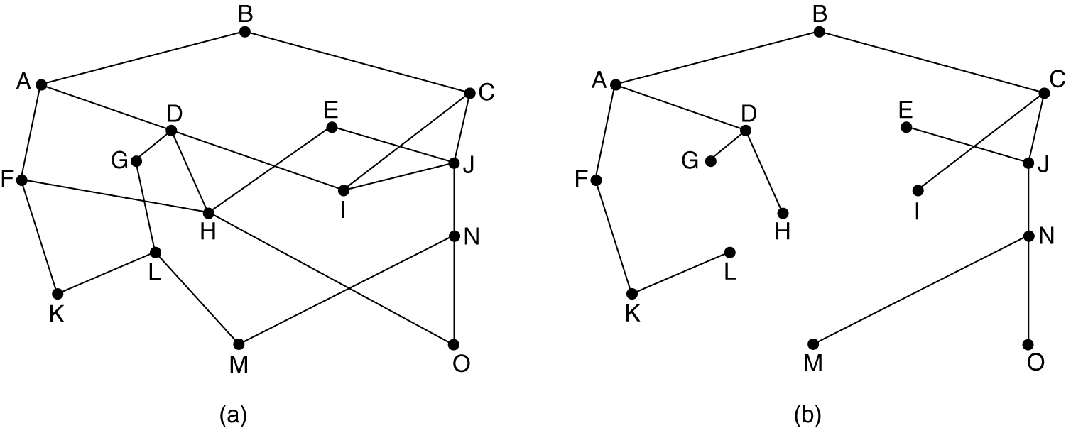
The Optimality Principle
(a) A subnet. (b) A sink tree for router B.

Slide 9
Shortest Path Routing
Idea is to build a graph of the subnet with
each node of the graph representing a router and
each arc of the graph representing a communication line (often called a link).
To choose a route between a given pair of routers, the algorithm just finds the shortest path between them on the graph.

Slide 10

Shortest Path Routing
One way of measuring path length is the number of hops.
Using this metric, the paths ABC and ABE in Fig. are equally long.
Another metric is the geographic distance in kilometers, in which case ABC is clearly much longer than ABE (assuming the figure is drawn to scale).

Slide 11
Dijkstra’s shortest path routing
Algorithm to find shortest path between two nodes of a graph
Each node is labeled (in parentheses) with its distance from the source node along the best known path.
Initially, no paths are known, so all nodes are labeled with infinity.
As the algorithm proceeds and paths are found, the labels may change, reflecting better paths.
A label may be either tentative or permanent.
Initially, all labels are tentative.
When it is discovered that a label represents the shortest possible path from the source to that node, it is made permanent and never changed thereafter.

Slide 12
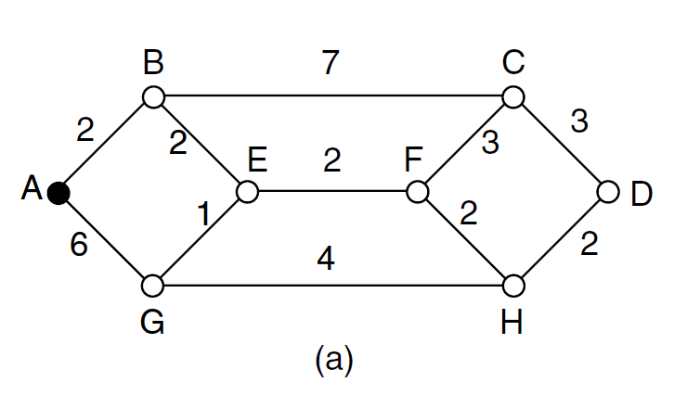
Find the shortest path from A to D using Dijkstra’s algorithm
Figure shows a weighted undirected graph where the weight represents distance
Let us start by marking node A as permanent, indicated by a filled-in circle

Slide 13
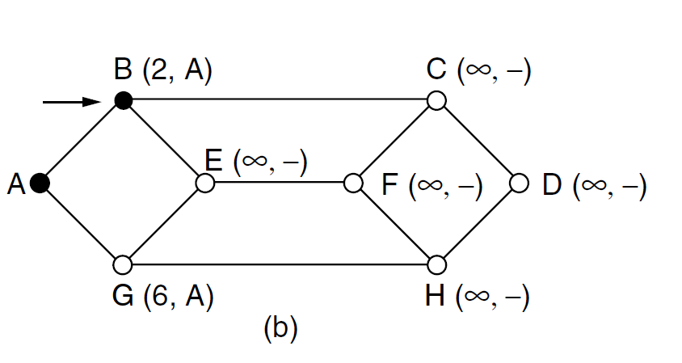

Slide 14
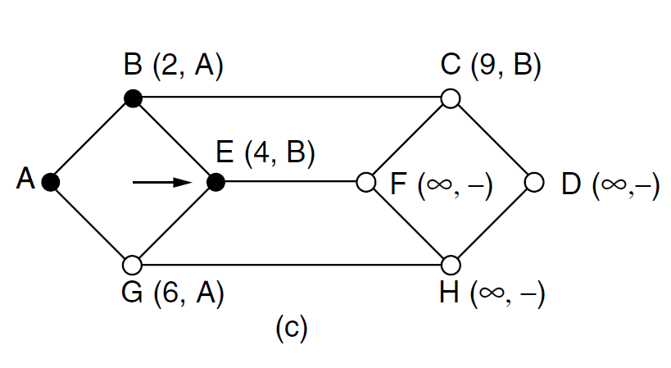

Slide 15
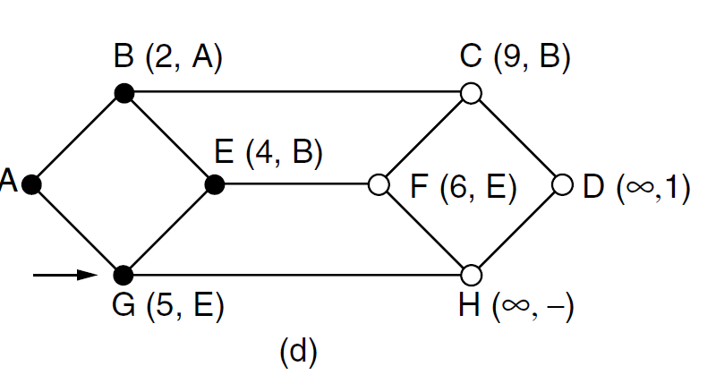

Slide 16
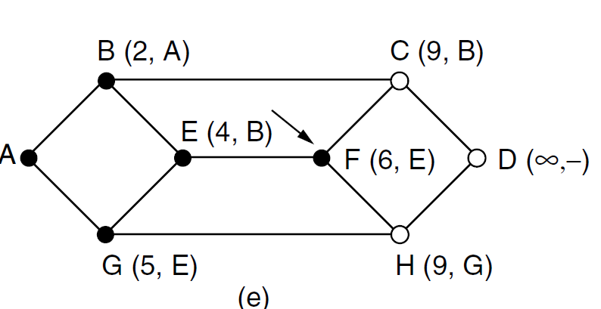

Slide 17
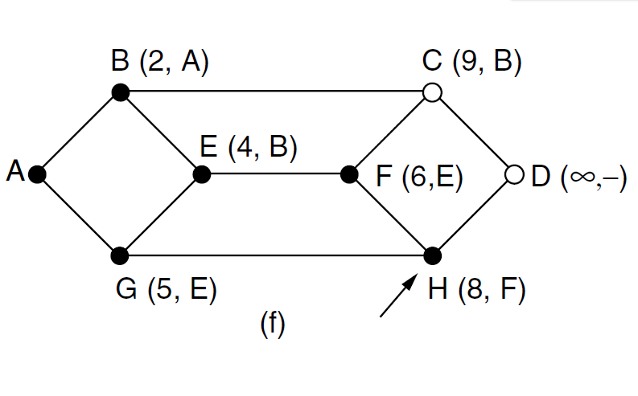

Slide 18
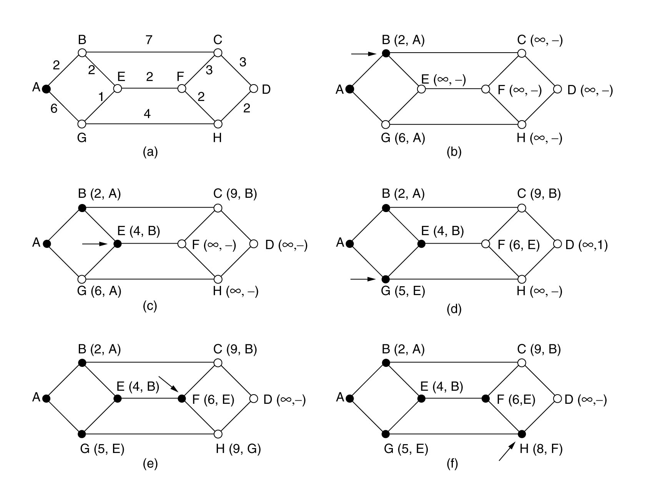
Shortest Path Routing
The first 5 steps used in computing the shortest path from A to D. The arrows indicate the working node.

Slide 19
Dijkstra’s shortest path routing
After making node A as permanent ,examine each of the nodes adjacent to A (the working node), relabeling each one with the distance to A.
Whenever a node is relabeled, we also label it with the node from
which the probe was made so that we can reconstruct the final path later.
If the network had more than one shortest path from A to D and we wanted to find all of
them, we would need to remember all of the probe nodes that could reach a node
with the same distance.
Having examined each of the nodes adjacent to A, we examine all the tentatively
labeled nodes in the whole graph and make the one with the smallest label
permanent, as shown in Fig. 5-7(b).
This one becomes the new working node.
We now start at B and examine all nodes adjacent to it. If the sum of the label on B and the distance from B to the node being considered is less than the label on that node, we have a shorter path, so the node is relabeled.
After all the nodes adjacent to the working node have been inspected and the tentative labels changed if possible, the entire graph is searched for the tentatively labeled node with the smallest value.
This node is made permanent and becomes the working node for the next round..
This Process is continued for all the nodes available in the graph.

Slide 20
Flooding:
Every incoming packet is sent out on every outgoing line except the one it arrived on.
Flooding obviously generates vast (infinite) numbers of duplicate packets
some measures are taken to damp the process.
One such measure is
to have a hop counter contained in the header of each packet, which is decremented at each hop, with the packet being discarded when the counter reaches zero.
Ideally, the hop counter should be initialized to the length of the path from source to destination.
If the sender does not know how long the path is, it can initialize the counter to the worst case, namely, the full diameter of the subnet.

Slide 21
Flooding
An alternative technique is to keep track of which packets have been flooded, to avoid sending them out a second time.
This is achieved by having the source router put a sequence number in each packet it receives from its hosts.
Each router then needs a list per source router telling which sequence numbers originating at that source have already been seen.
If an incoming packet is on the list, it is not flooded.

Slide 22
Flooding:
To prevent the list from growing without bound, each list should be augmented by a counter, k, meaning that all sequence numbers through k have been seen.
When a packet comes in, it is easy to check if the packet is a duplicate;
if so, it is discarded.
Furthermore, the full list below k is not needed, since k effectively summarizes it.

Slide 23
Variant: Selective flooding:
Routers do not send every incoming packet out on every line,
It will send only on those lines that are going approximately in the right direction
There is usually little point in sending a westbound packet on an eastbound line unless the topology is extremely peculiar and the router is sure of this fact.

Slide 24
Applications of flooding
In military applications, where large numbers of routers may be blown to bits at any instant, the tremendous robustness of flooding is highly desirable.
In distributed database applications, it is sometimes necessary to update all the databases concurrently, in which case flooding can be useful.
In wireless networks, all messages transmitted by a station can be received by all other stations within its radio range.
Used in metric against which other routing algorithms can be compared.

Slide 25
Advantages of Flooding:
always chooses the shortest path because it chooses every possible path in parallel.
Consequently, no other algorithm can produce a shorter delay (if we ignore the overhead generated by the flooding process itself).

